Slide 1
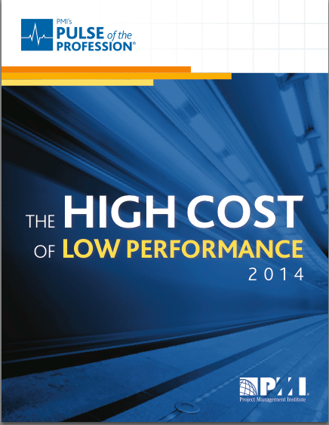
PMI-AGC Bahrain Presentation
by Saira Karim
April 2014

Slide 2
Importance and relevance of PMI’s Pulse of the Profession reports
The newest edition of the Pulse features feedback and insights from over 2,500 project management leaders and practitioners across North America; Asia Pacific; Europe, the Middle East, and Africa (EMEA); and Latin America and Caribbean regions.

Slide 3
Provides guidance to the questions:
How can mature project management practices lead to a competitive advantage?
What lessons can be learned from high performers that can be replicated across organizations of all types to improve their value?

Slide 4
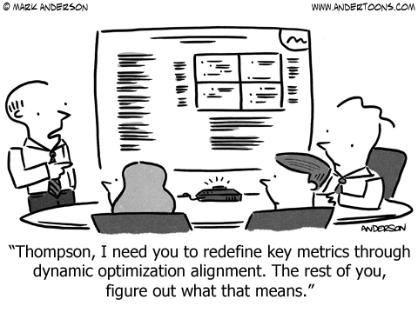

Slide 5
Key Themes
Strategic initiative management
The wide Chasm - Organizational agility
The strategic alignment Imperative
Driving Organizational Success
People
Process
Outcome
Notes:
20 pages

Slide 6
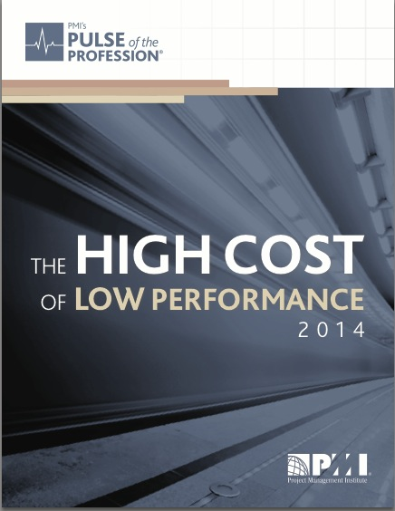
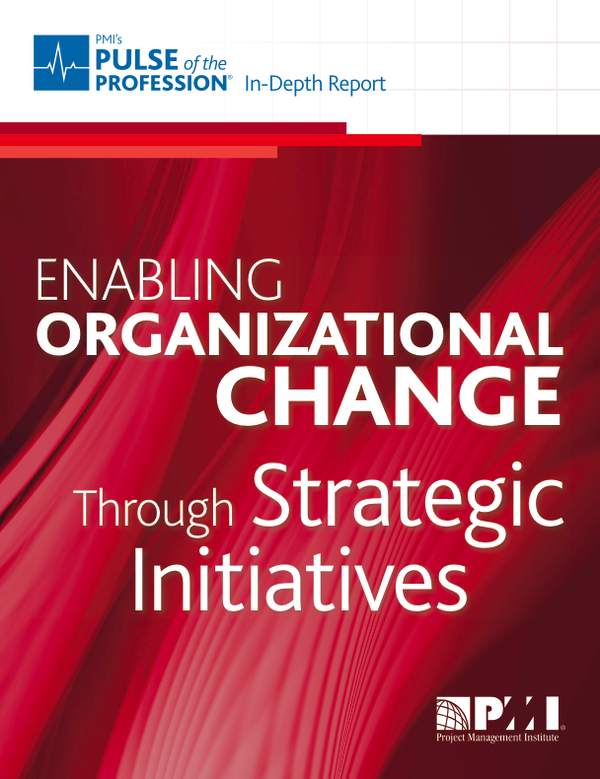
Focus now on:
Strategic Initiative Management to drive organization success through improved efficiency.
88% of executives say that strategy implementation is important to their organizations.
61% acknowledge that their firms often struggle to bridge the gap between strategy formulation and its day-to-day implementation.
Very few organizations (9 percent) rate themselves as excellent on successfully executing initiatives to deliver strategic results.
Notes:
This gap demonstrates a lack of understanding among organization executives that all strategic change happens through projects and programs.
Consequently, only 56 percent of strategic initiatives meet their original goals and business intent.

Slide 7
Strategy Strategic Initiatives Strategic Initiative Management

Slide 8
Definition of a Strategic Initiative
A strategic initiative is an endeavor intended to achieve three interrelated outcomes:
A boundary-spanning vision or “strategic intent”
Realization of important benefits to “strategic” stakeholders
Transformation of the organization
Notes:
top consultancies – IBM, PwC and McKinsey been saying that programs, portfolios & strategic initiatives – must be aligned to the strategy of the organisation to achieve success.

Slide 9
Strategic initiative management
Strategic Initiatives
Identify & prioritize the initiatives that will close specific performance gaps
Implement & execute initiatives through adoption of best practice
Portfolio, Program & Project Management.
Governance
Progress reporting to senior management
Strategy - position & fit

Slide 10
“Strategy is important but results are only delivered through execution”
Saira Karim
High-performing organizations successfully complete 89% of their projects, while low performers complete only 36% successfully.
Projects and programs that are aligned to an organization’s strategy are completed successfully more often than projects that are not. PMI’s earlier research reported that aligning projects with strategic objectives has the greatest potential to add value to an organization.
Notes:
This difference in success results in high-performing organizations wasting nearly 12 times less than low performers
But on average organizations report that three of five projects are not aligned to strategy.

Slide 11
Question: What practices can we focus on to improve value & competitive advantage?

Slide 12
This report highlights key practices that maximize organizational value.
Mature project management capabilities
Focus on talent
Change management
Insist on a benefits realization review.
Notes:
High performers successfully complete more projects. They are more flexible and waste fewer dollars.

Slide 13
The wide Chasm

Slide 14
“Organizations lose an average of $109 million for every $1 billion spent on projects”
(Figure 1)
PMI’s 2014 Pulse of the Profession research shows that organizations face a wide chasm between their actual state and the state of success.

Slide 15
Declining focus on training / development of PM’s
Shift in role of PMO’s to become more strategic
Metric: $lost
= average % of projects not meeting goals X average % of project budget lost if project fails.

Slide 16
Organizational Agility

Slide 17
“The bottom line is that a lack of organizational agility significantly diminishes the success of projects and strategic initiatives”
Organizations that are highly agile, nimble and able to respond quickly to changing market dynamics complete more of their strategic initiatives successfully than slower, less agile organizations.
Only 15% of organizations report high organizational agility

Slide 18
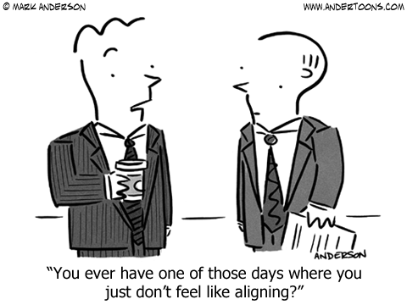
The strategic alignment imperative

Slide 19
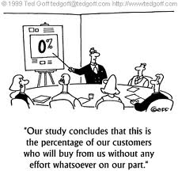
IBM’s research reveals that in the next three to five years, a growing number of CEOs expect to include customers in every part of their business, and 40 percent more CEOs plan to include customers in their organization’s business strategy development compared to today.
Customers will have more of a role in shaping business strategy:
A shift in addressing customer demands
A shift in shaping strategy
A shift in customer expectations
Notes:
These findings suggest that improved organizational agility is essential to effectively adapt to this shift in shaping strategy
Signs of cautious optimism so now is the time for organizations to regroup, assess and position themselves to increase performance

Slide 20
Driving organizational success *People *Processes *Outcomes

Slide 21
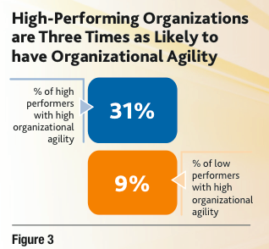
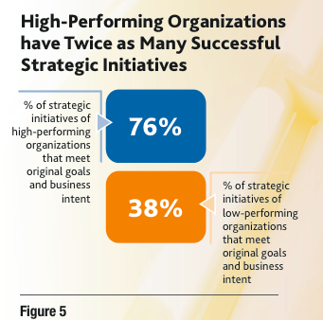
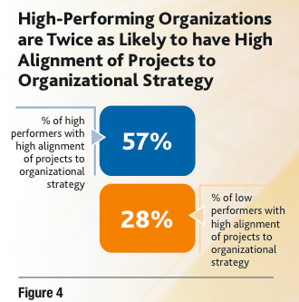
Understanding what practices, both strategic and tactical, high- performing organizations have in place is crucial to improving an organization’s success.

Slide 22
Bridging the wide chasm
Along with high alignment of their projects to organizational strategy and organizational agility, high-performing organizations succeed through a strategic focus on:
people,
processes and
outcomes.

Slide 23
Driving Organizational Success – People Talent management
Problem
Few organizations are focusing on knowledge transfer and this might be hampered by the fact that nearly two-thirds of organizations report using outsourced or contract project managers.
PMI’s Pulse of the Profession In-Depth Report: The Competitive Advantage of Effective Talent Management, showed that organizations that align their talent management to strategy have more successful projects and waste fewer project dollars.
“Our research revealed that high-performing organizations are more than twice as likely as their low-performing counterparts to align talent management to organization strategy—a significant competitive advantage”.
Notes:
Managing people through change
Executive sponsors
Contract & outsourced PM’s likely to increase in from 20% in 2013 to 26% 2014

Slide 24
Driving Organizational Success - People
Change Management
Vital to effective organizational change is the executive sponsor—the person within the organization who champions change.
PMI’s Managing Change in Organizations: A Practice Guide outlines the importance of executive sponsors on projects and programs that drive organizational change.
Our latest Pulse research confirms that actively engaged sponsors is again the top driver of project success.
Notes:
However, the average percentage of projects with active sponsors has remained flat: for the past three years, organizations report that less than two in three projects have actively engaged sponsors (Figure 8).

Slide 25
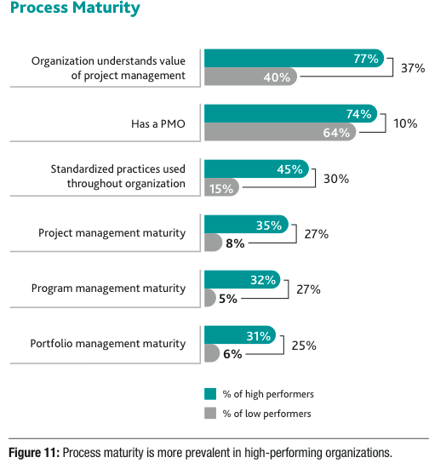
Driving Organizational Success - Processes
The Pulse data demonstrates that process maturity leads to success.
Despite this, the findings in this report reveal that many organizations are not taking sufficient action to mature their processes.
Notes:
for the past several years, our Pulse research has confirmed that organizations can clearly benefit from maturing their project, program and portfolio management processes

Slide 26
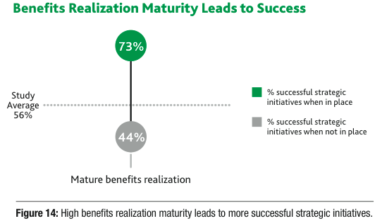
Driving Organizational Success - Outcomes
Benefits realization is the practice of ensuring that the outcome of a project produces the projected benefits claimed in the business case.
This is achieved through the establishment, measurement and communication of the expected benefits of an organization’s initiatives.

Slide 27
Conclusion
Key themes
Strategic initiative management
The wide Chasm - Organizational agility
The strategic alignment Imperative
Driving Organizational Success
People
Process
Outcome
Key practices
Focus on talent
Change management
Mature project management capabilities
Insist on a benefits realization review.
Notes:
20 pages

