Slide 1
Prosci Change Management Methodology Bahrain Customs Affairs OFOQ project Case study

Slide 2
Presented by Ibrahim Hassan Bihery PMP
Program and project management Consultant at

Slide 3
Agenda
Methodology
Bahrain Customs OFOQ project Case study
Challenges and lessons learned

Slide 4
Methodology
Change management definition
Primary reasons for applying change management in projects
The five building blocks of successful individual change ,Procsi ADKAR model
Procsi organizational change manage processes
Connecting individual and organizational change management
Projects which are good candidates for applying change management
What is Prosci’s Organizational change management process

Slide 5
Change Management Definition
Many innovation projects bring a change to the way work is done on organization level. Success of those changes will be more dependent on how individuals in the organization embrace the change.
Individuals need to accept and support the change otherwise project’s success is at real risk

Slide 6
Change Management Definition-continued
The process, tools and techniques to manage the people-side of change to achieve the required business results.
OR
Change Management is a structured approach to transitioning individuals, teams and organizations from a current state to a desired future state

Slide 7
Primary reasons for applying change management in projects
Increase probability of project success
Manage employee resistance to change
Build change competency into the organization
Organizations understand,, accept, and support needed business changes

Slide 8


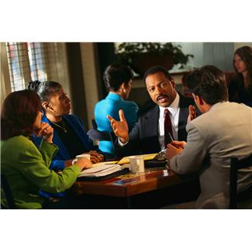
Projects which are good candidates for applying change management
Projects that impact wide range of people ’ behaviors and work processes e.g.
road , dams constructions
business process re-engineering
merger or acquisition
ICT projects

Slide 9

What is Prosci’s Organizational change management process
A structured process for managing the ‘people side’ of change on a project or initiative
    Research-based
    Holistic
    Easy-to-apply
    Scalable

Slide 10

The five building blocks of successful change
Prosci ADKAR Model
Awareness |  | Awareness of the need for change
Desire |  | Desire to participate and support the change
Knowledge |  | Knowledge on how to change
Ability |  | Ability to implement required skills and behaviors
Reinforcement |  | Reinforcement to sustain the change

Slide 11
Prosci’s Organizational change management process & Plans

Slide 12
Prosci’s Organizational change management process-continued
Communication Plan
Sponsor Roadmap
Training Plan
Resistance Management
Coaching

Slide 13
Connecting individual and organizational change management

Slide 14
Bahrain Customs Affair OFOQ Project Case Study
OFOQ project & Its Objectives
BCA Change characteristics assessment results
BCA Organizational attributes assessment results
BCA Change Management Plans (Communication Plan, Sponsor Roadmap, Training Plan, Resistance Management Plan, Coaching)
Assessing the results
Challenges & lessons learned

Slide 15
OFOQ project & Its Objectives
OFOQ project scope is to supply, install commission, operate & maintain an integrated Trade Facilitation System (ITFS) to support and reengineer BCA business processes.
Revenue
Facilitation
ITFS
Protection

Slide 16
OFOQ project & Its Objectives-Continued
To replace the existing eCAS with a fully fledged trade facilitation system that will significantly streamline & enhance the Custom Affairs back-end & front-end operations
To be in line with the Kingdom of Bahrain’s 2030 vision & support Bahrain’s aspiration of becoming the leading Trade hub in the region
To provide best-in-class services to the business community, support the Kingdom’s aspirations to become a regional & global trade hub & adhere to national & international security requirements
To promote increased trade between the Kingdom of Bahrain & the international trading community through the fast & efficient application of customs controls, policies & procedures, together with revenue collection, whilst at the same time mitigating associated risks to ensure security & public safety.

Slide 17
BCA Change characteristics assessment results
AFOQ implementation has a dual purpose , since it is not only about implementing a computer system but it aims to change the customs processes to comply with the recognized customs best practices. The project will re-engineer some of the existing processes and introduction of new practices e.g. binding the bill of entry with the manifest and risk management to facilitate the legal trade and protect the kingdom.
The project will impact 24 internal employees groups in the head office and the outlets and 4 external group (importers , exporters , clearing agents and other government regulatory organizations
In total 320 front end employees and 36 managers and supervisors will be impacted by the project

Slide 18
BCA Organizational attributes assessment results
Change of Bahrain Customs will be easy for the following reasons:
Employees have a homogeny Cultural background
Employees culture accepts change
More than 70% of the employees’ age is below 50
Management is centralized
Noticeable part of the employees have military background
The kingdom is small and number of employees is very less.
Employees have a homogeny Cultural background
Employees are loyal to the organization and leadership

Slide 19
BCA Change Management Plans
Five plans are prepared:
Communication Plan
Sponsor plan
Coaching plan
Resistance management Plan
Training Plan

Slide 20
Communication Plan
Audience are grouped in 5 groups:
Top and senior management
Middle management and supervisors
Employees
Government regularity organizations
Importers , exporters and clearing agents

Slide 21
Communication Plan -Continued
Different messages articulated to each group and will be communicated as below
Initially
Before going live in each outlet
After going live in each outlet
Media of communication is defined as follows:
Presentations to Top and senior management
Letters and brochure to Middle management , supervisors and Employees
Letters to Government regularity organizations
A town hall event for Importers , exporters and clearing agents

Slide 22
Sponsor Roadmap
Target group | Activity | Notes
with the project team | A message to the project team recognizing their effort and encouraging them | This message can be communicated in a short meeting or send by e-mail to all of them
With trade community and clearing agents | A town hall meeting announcing the project and highlighting the expected benefits
with employees | A message to all employees assuring them that the initially experienced difficulties with the system will gradually be overcome and requesting them to interact with the new system positively | Can be distributed in a form of flyer and through e-mail

Slide 23
Training Plan
Training process
Assess training needs
Organize training sessions
Evaluate outcome
Training needs Assessment
Training outcome Assessment
Training Attendance

Slide 24
Resistance Management Plan
Symptoms of Resistance
Not performing tasks required by the project e.g. not attending trainings or workshops
Raising un-objective concerns
Intentionally entering wrong data
Spreading rumors
Root Cause for Resistance
None awareness of the change
No desire for change
Insufficient knowledge of the system
Disability in using the system

Slide 25
Resistance Management Plan-Continued
Groups who may resist the change
Reasons for the Resistance
Some middle managers and supervisors
Outlets employees
Clearing Agents
Difficulties faced at port and airport
Lack of knowledge of the customs best practices
Adherence to the old

Slide 26
Resistance Management Plan-Continued
Tactics to handle Resistance
Prepare a log for all employees to register their concerns and comments. Analyze the log , respond to and consider objective concerns
Explain benefits of each audience group
Convert the strongest dissenters
Use carrot and stick if necessary
Communicate and implement consequences of supporting the change
Conduct intensive training to those who require it
Ongoing Coaching by immediate supervisor/manager
Remove barriers e.g. upgrade and replace clients’ machines

Slide 27
Resistance Management Plan-Continued
Root cause | How to overcome
None awareness of the change | Republish the awareness messages using new media channels
No desire for change | Prepare a log for all employees to register their concerns and comments. Analyze the log , respond to it and consider objective concerns Explain benefits of each audience group Convert the strongest dissenters Use carrot and stick if necessary Communicate and implement consequences of supporting the change
Insufficient knowledge of the system | Conduct intensive training to those who require it Ongoing Coaching by immediate supervisor/manager
Disability in using the system | Remove barriers e.g. upgrade and replace clients’ machines

Slide 28
Coaching Plan
The plan is of three stages:
enable middle management and supervisor to coach their subordinates
Conduct groups coaching by middle management and supervisor
Develop individual employees (this is an on going activity which will span beyond the project)

Slide 29
Assessing the results
Feedback analysis
Corrective action plan
Incentives and celebrating successes

Slide 30
Challenges & lessons learned
Challenges
A professional project manager joined the project very late
Processes in different outlet is not unified and each one was working as an autonomous organization
Change management started late
Non involvement of all stakeholders
Lack of effective communication between different parties
Lack of detailed analysis of project environment

Slide 31
Challenges & lessons learned -Continued
Lessons Learned
Change management activities should start in very early stage of the project if not before the project initiation
Professional project manager is a must in any project (Business domain expert is not enough to grantee success)
Change management should be handled in structured
IT Projects in government organizations can not succeed without proper change management

Slide 32
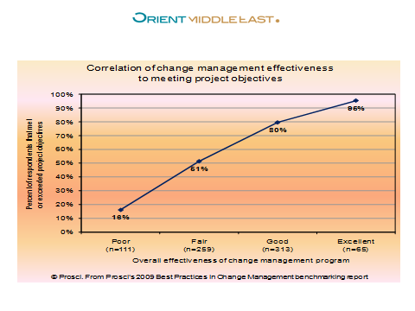

Slide 33
Q & A
Thanks

