Slide 1
The Portfolio Management Approach – An Overview
Dr. George Sifri
D.B.A., PMP, CCP, CISA, CM, PSP, EVP, CCE, PMI-RMP, PMI-SP gsifri@ieee.org

Slide 2
Learning Objectives
At the end of this seminar the participants should be able to:
  Define vocabulary of strategic management
  Define a portfolio, and portfolio management
  Describe a portfolio approach and how it can be implemented through portfolio management
  Provide an overview of the portfolio management process
  Describe the two groups of portfolio management processes

Slide 3
What is a Vision Statement?
It is an aspiration around which a strategist might seek to focus the attention and energies of members of the organization
It generally expresses long-term action horizon
It is ambitious and it forces the firm to stretch
Its’ ambiguity allows flexibility for changing strategy or implementation tactics
It answers the apparently simple but challenging question:
  “What do we want to become?”

Slide 4
Example of a Vision Statement
Sony’s vision in early 1950’s
  “becoming the company that most changes the worldwide image of Japanese products as being of poor quality.”
CitiBank’s vision in 1915
  “the most powerful, the most serviceable, the most far reaching world financial institution the world has ever seen.”

Slide 5
What is a Mission Statement?
It is a general expression of the overall purpose of the organization
It is ideally is in line with the values and expectations of major stakeholders
It is concerned with the scope and boundaries of the organization
It answers the apparently simple but challenging question:
  “What business are we in?”

Slide 6
Example of a Mission Statement
eBay’s
  “To provide a global trading platform where practically anyone can trade practically anything.“
Amazon’s
  “To build a place where people can come to find and discover anything they might want to buy online.”
Google’s
  “To organize the world’s information and make it universally accessible and useful.”

Slide 7
Business Goals, Business Objectives, and Business Targets
A Business goal usually means a general aim in line with the mission:
  It may well be qualitative in nature
  It answers the question:
    Why do we want to tackle this initiative?
Business objectives translate goals into specific, and measureable criteria to answer the question:
  How do we know that we achieved the business goals?

Slide 8
Examples of Business Goals, and Business Objectives
Business Goals | Business Objectives within five years
 | KRA | KPI | Measure | Metric
Improve profitability | Cost | Operating Expenses/Unit produced | $ | < 10% of IA
 |  | Administration Expenses/Unit sold | $ | < 5% of IA
 | Sales | Gross Revenues from Products Sold | $ | Increase by 20%
Enhance safety | Construction | Falling Accidents | Count | BIC
Improve competitive position | Customer Loyalty | Market Share | % | Increase by 10%
 |  | Gross Units Sold | Count | Increase by 5%
KRA = Key Result Area
KPI = Key Performance Indicator
BIC = Best in Class
IA = Industry Average

Slide 9
Discussion
What are the differences between objectives and targets?
Objectives
Imperative
Subject to a “Management of Change” process
If the project’s objectives cannot be achieved or not valid anymore then either the key stakeholders change the project’s objectives or they kill the project
They present the needs of the key stakeholders
Targets
They represent the expectations of the key stakeholders

Slide 10
What is Strategy?
Strategy is the direction and scope of an organisation over the long term, which achieves advantage in a changing environment through its configuration of resources and competences with the aim of fulfilling stakeholder expectations

Slide 11
Discussion
What do we mean by a strategic competitive advantage?
Four criteria for a strategic competitive advantage:
Creates value in the eyes of the key stakeholders
Rare
Costly to imitate
Nonsubstitutable

Slide 12



Hierarchical Levels of Strategy
Corporate
Strategy
Business you should be in
Business Strategy
Tactics
to beat the competition
Functional Strategy
Operational methods
to implement the tactics

Slide 13
The Strategic Management Process
External
Analysis
Long-Term
Goals &
Objectives
Vision
& Mission
Strategic
Choice
Strategy
Implementation
Competitive
Advantage
Internal
Analysis

Slide 14
Elements of Strategic Management
Strategic capability
The environment
Expectations and purposes
The strategic position
Business level strategies
Enabling
Functional level strategies
Corporate level strategies
Organizing
Managing change
Strategic choices
Strategy into action

Slide 15
What is a Portfolio?
“A collection of projects or programs and other work that are grouped together to facilitate effective management of that work to meet strategic business objectives.’’
Source: PMBOK® Guide 2008 Edition; page 8

Slide 16
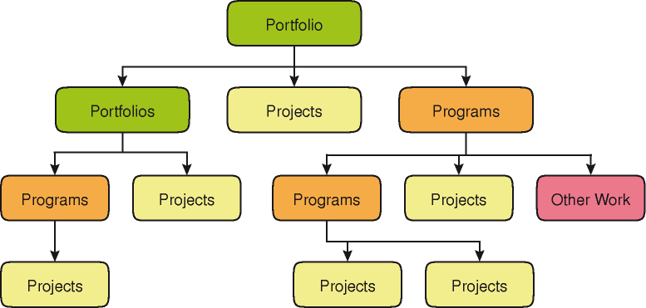
What is a Portfolio?
Source: The Standard for Portfolio Management, PMI 2nd Edition, page 5, figure 1-1

Slide 17
What is a Portfolio?
All components of a portfolio exhibit certain common features:
  They represent investments made or planned by the organization
  They are aligned with the organization’s strategic goals and objectives
  They typically have some distinguishing features that permit the organization to more effective management
  The components of the portfolio are quantifiable; that is, they can be measured ranked or prioritized

Slide 18
What is Portfolio Management?
‘’The centralized management of one or more portfolios, which includes identifying, prioritizing, authorizing, managing and controlling projects, programs and other related work to achieve specific strategic business objectives.’’
Source: PMBOK® Guide 2008 Edition; page 9

Slide 19
Strategic Linkage and Portfolio Balancing
Vision
Goal 1
Strategy 1.1
Strategy 1.2
Strategy 1.3
Goal 2
Strategy 2.1
Strategy 2.2
Strategy 2.3
Strategy 2.4
Goal 3
Strategy 3.1
Strategy 3.1
Project 1.1.1
Project 1.1.2
Project 1.1.3
Project 1.3.1
Project 1.3.2
Project 2.1
Project 2.2.1
Project 2.2.2
Project 2.3.1
Project 2.3.2

Slide 20
Example of Strategic Linkage
Vision
Growth to $ 5 Billion
Acquisitions
Developing sales channels in Asia
Continuous customer participation in our decisions
Buy & integrate Y
Buy & integrate Z
Building industry-leading competence in X
Research and recommend 3 channels
Establish IP security
Establish 5 customer involvement centers
Fund university collaborative X
Build sustainable recurring program
Improved customer satisfaction
Increased $ from new products

Slide 21
Discussion
What are the requirements for effective portfolio management?
  Clarity on delegation of authority; single point of accountability for project selection
  Clearly define process and guidelines for project selection and budgets
  Clearly defined goals, objectives, and targets both strategic and operational
  Supporting behavior exhibited by key stakeholders
  Accurate, timely, and relevant information for decision making

Slide 22
Portfolio Management Process Groups
Aligning process group
  This group determines how components will be categorized, evaluated and selected for inclusion, and managed in the portfolio
Monitoring and controlling process group
  The group reviews performance indicators periodically for alignment with strategic objectives

Slide 23
Aligning Process Group Overview
The group consists of the following processes:
  Identify components
  Categorize components
  Evaluate components
  Select components
  Prioritize components
  Balance portfolio
  Communicate portfolio adjustment
  Authorize components

Slide 24
Identification
Key activities include:
  Comparing ongoing components and new component proposals with a predetermined component definition and related key descriptors
  Rejecting components that do not fit within the predetermined definition
  Classifying identified components into predefined classes of components, such as project, program, portfolio, and other works

Slide 25
Contents of a Business Case
Executive summary
Business requirements
Cost benefits analysis
Risk management

Slide 26
Business Requirements
What is the business problem that the project is trying to address?
What other projects or systems that may be effected by this project?
How does this project link to the business strategy?
How does this project impact partners, business units, functional divisions, etc?
Why is the organization doing this project?
Who will benefit from this project?
Why do the project now?
What are the success criteria of this project?
How do we know that the business need is satisfied?

Slide 27
Cost Benefit Analysis
What are the tangible and the intangible project benefits?
How to quantity costs and benefits whenever possible?
Do you have at least two viable alternatives to solve the problem?
What are the costs and the benefits associated with each alternative?
How well each alternative solve the problem?
Which alternative is the preferred one and why?
Under what conditions the next alternative in the list becomes the preferred alternative?
What are the costs to other partners or customers?
What are the basis for the costs estimate?
How much will this project cost to implement and maintain?
How much will this project save?

Slide 28
Risk Management
What are the active risks?
What are the dormant risks?
Do we have responses to active risks in place?
Is the level of residual risks acceptable to approve the project to move to the next phase?
Are there any show stoppers?
Are there any specific responses that must be implemented before moving to the next phase?
What are the chances that this project will be successful?
What will be done to maximize the chances for success?
Is there enough reserve and contingency in the budget and schedule?

Slide 29
Categorize Components
Key activities include:
  Identifying strategic categories based on the strategic plan
  Comparing identified components to the categorization criteria
  Grouping each component into only one category

Slide 30
Discussion
Give examples of categories that may be used to group and compare a portfolio’s components
Categories
Increased profitability (revenue increase, cost reduction, etc.)
Risk reduction
Efficiency improvement
Legal obligation
Market share increase
Process improvement
Continuous improvement
Business imperatives (e.g. IT compatibility )
Subcategories
Size (e.g., effort budget)
Duration
Component type (e.g., projects, programs, other work)
Phase

Slide 31
Evaluate Components
Key activities include:
  Evaluating components with a scoring model comprising weighted key criteria
  Producing graphical representations to facilitate decision-making in the selection process
  Making recommendations for the selection process

Slide 32
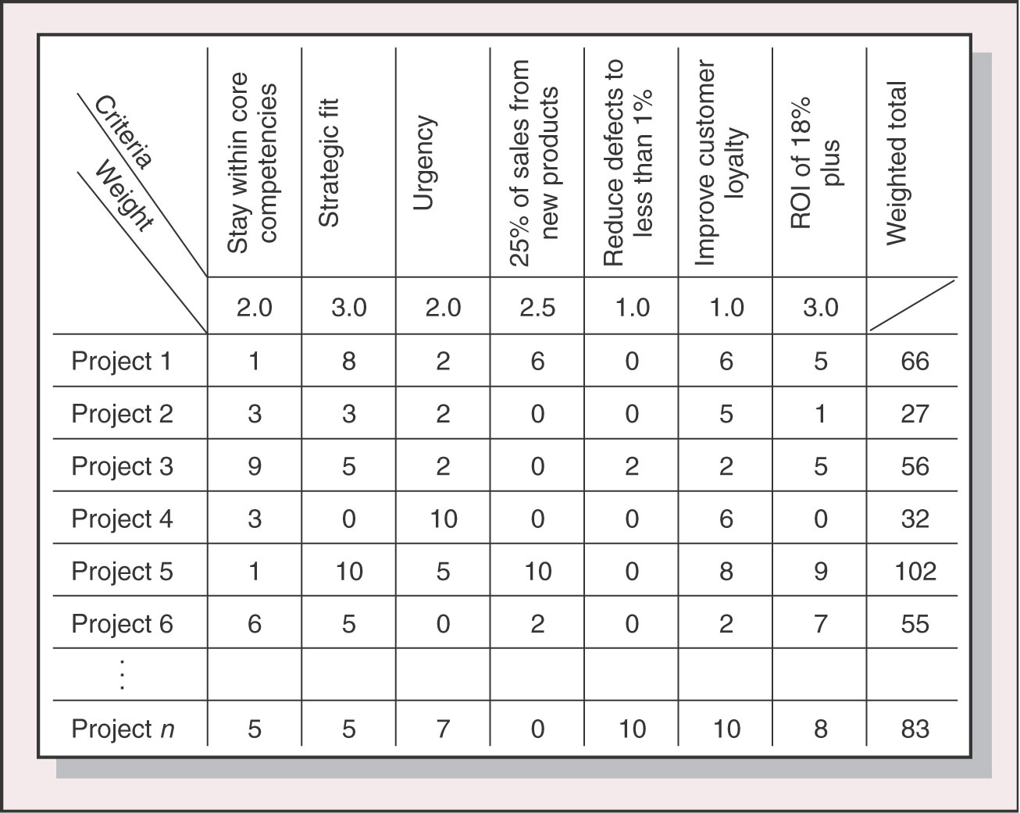
Project Scoring Model
© 2003 The McGraw-Hill Companies, Inc., All Rights Reserved.

Slide 33
Project Scoring Model
Total project score
(70 of 100 points)
Project deliverable
(30 of 40 points)
Value to the organization (40 of 60 points)
Total cost
(5 of 10 points)
Financial
(20 of 24 points)
Strategic
(20 of 36 points)
Duration
( 5 of 8 points)
ROI
( 6 of 8 points)
Competitive issues
( 4 of 6 points)
Scope
(10 of 12 points)
Payback period
(4 of 4 points)
New business issues
(10 of 12 points)
Quality
(10 of 10 points)
Benefit/Cost Ratio
(10 of 12 points)
Capability improvement
(6 of 18 points)

Slide 34
Example of Building a Scoring Model for R&D Projects
Example applied to R&D project:
  M = Total market size
  S = Potential market share
  T = Probability of technical success
  C = Project cost
  Score = T * ( M + 2 * S ) / C

Slide 35
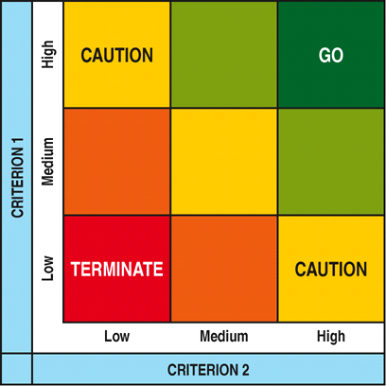
Graphical Representation
Source: The Standard for Portfolio Management, PMI 2nd Edition, page 59, figure 4-7

Slide 36
Select Components
Key activities include:
  Selecting components based on the evaluation results and comparison to selection criteria
  Producing a list of components for prioritization

Slide 37
Discussion
What are some of the required supporting behaviors of the evaluation and selection team?
Understand the business context and strategy
Consider multiple options and scenarios of future outcomes
Develop and implement a consistent and objective approach to option comparisons
Assess the viability of the project
Assess the investment quality versus risk and uncertainty

Slide 38
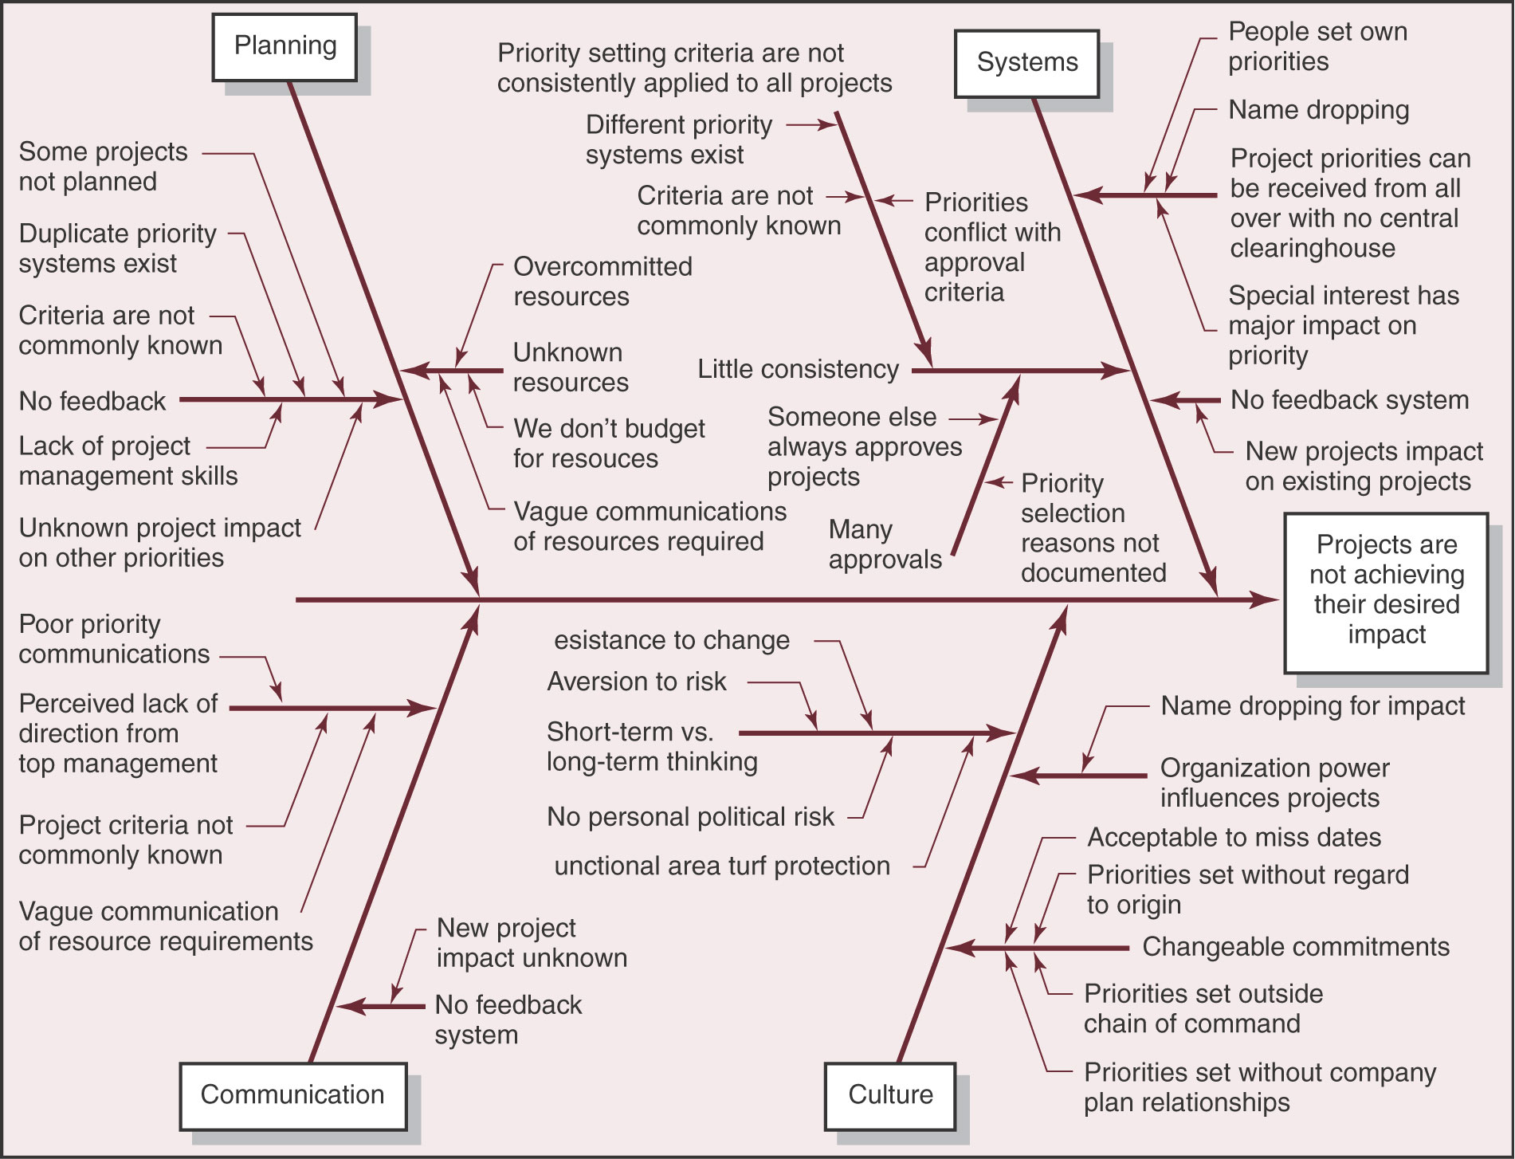
© 2003 The McGraw-Hill Companies, Inc., All Rights Reserved.

Slide 39
Project Selection and Prioritization Methods Categories
The methods used for project selection discussed in this module can be categorized as follows:
  Ranking
  Economic Decision Theory Models

Slide 40
Project Selection Methods Categories
Project Selection Methods Categories
Ranking Techniques
Pairwise Comparison
Scoring Models
Economic Decision Theory Models
Net Present Value (NPV)
Internal Rate of Return (IRR)
Discounted Payback Period (DPP)
Investment Efficiency (IE)

Slide 41
Pairwise Comparison - Dominance Count
Total Votes
9 for
A
A
A
2
7 for
B
B
B
2
A
2
B
3
8 for
C
C
C
2
C
1
A
3
B
1
C
3
6 for
D
D
D
1
D
3
D
1
A
2
B
C2
D
1
10 for
E
2
1
E
E
2
E
3
E
E
2
2
3

Slide 42
Economic Decision Theory
Attempt to evaluate projects on their contribution to the firm’s profits
Take into account the cash flow involved with the project from initiation, through development, to sales, and either end-of-life cycle or some specified time horizon
Methods include:
  Discounted cash flow models such as Net Present Value
  Internal rate of return
  Payback period

Slide 43
Economic Indicators in Action
+
Net Present Value
Discounted Payback Period
Procure and Construct
Cumulative PV
De-commission
Reduced OPEX
Pre-project
Commission
Operation
Design
Demolish
Asset Life Cycle
-
Reduced cycle time
Maximum Discounted Cumulative Cash Exposure
Reduced CAPEX

Slide 44
Prioritize Components
Key activities include:
  Confirming the classification of components in accordance with predetermines strategic categories
  Assigning scoring or weighting criteria for ranking components
  Determining which components should receive highest priority within the portfolio

Slide 45
Balance Portfolio
Key activities include:
  Adding new components that have been selected and prioritized for authorization
  Identifying components that are not authorized based on the review process
  Eliminating components to be suspended, reprioritized, or terminated based on the review process

Slide 46
Communicate Portfolio Adjustment
Key activities include:
  Communicating portfolio decisions to key stakeholders, both for components included in and those excluded from the portfolio
  Acquainting stakeholders with the communications plan which may include review cycles, timelines, etc
  Communicating expected and actual portfolio results, identifying variances and corrective action

Slide 47
Authorize Components
Key activities include:
  Communicating portfolio balancing decisions to key stakeholders, both for components included and those not included in the portfolio
  Authorizing selected components and inactivating or terminating components of the portfolio
  Reallocating budget and resources for inactive and terminated components
  Allocating financial and human resources to execute selected portfolio components
  Communicating expected results

Slide 48
Monitoring and Controlling Process Group Overview
The group consists of the following processes:
  Review and report portfolio performance
  Monitor business strategy changes

Slide 49
Review and Report Portfolio Performance
Key activities include:
  Reviewing component sponsorship, accountability, and other ownership criteria against organizational governance standards
  Reviewing components priority, dependencies, scope, expected return, risks, and financial performance against portfolio control criteria and organizational value and investment criteria
  Reviewing expected impact of business forecasts, resource utilization, and capacity constraints on portfolio performance

Slide 50
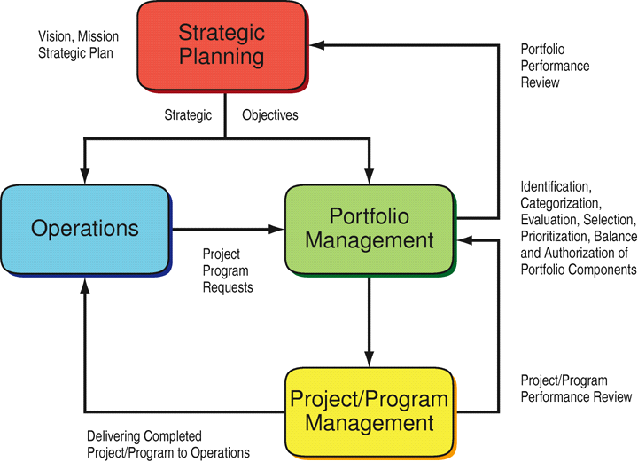
The Business View of Portfolio Management

Slide 51
Portfolio Metrics
Category | Key Questions | Sample Metrics
Portfolio Mix | Is our funding aligned with strategic objectives? | % of Portfolio spend in “run the business” % of Portfolio in “grow the business” % of Portfolio in “innovate the business” % of Portfolio in Short/Medium/Long-term projects % of portfolio in Large and Extra Large Projects

Slide 52
Portfolio Metrics
Category | Key Questions | Sample Metrics
Demand and capacity | Do we have the right prioritization and sequencing of projects given current capacity? | % of growth in project intake % of growth in initiatives Resource utilization (human, material, capital) Recruiting pipeline Production capacity
Value | For our portfolio, to what extent did we achieve our objectives? | % on time % on budget Portfolio and sub-portfolio IRR $ saved for consolidation efforts

Slide 53
Portfolio Metrics
Category | Key Questions | Sample Metrics
Portfolio health | For programs/projects in-flight, how is our execution progressing? | Counts and amounts for programs and projects # of issues by severity
Financial management | How effectively are we managing program and project budgets and what are the financial trends? | % variance to plan % funding in-flight $ committed but not spent

Slide 54
Graphical Representations
Progress measurement techniques can also use graphical representations to help compare desired and/or planned situations with actual situations
A typical graphical tool used is the “traffic light” analogy
  Green: evaluation/forecast situation in line with desired results
  Yellow: some difficulty encountered/perceived but effective corrective action possible or being implemented
  Red: critical situation calling for replanning, an urgent intervention, that might even include postponing implementation or terminating the component

Slide 55
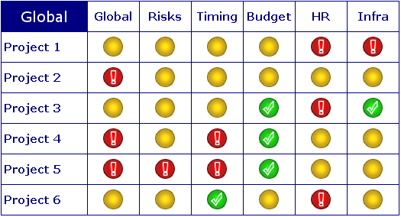
Traffic Light Analogy

Slide 56
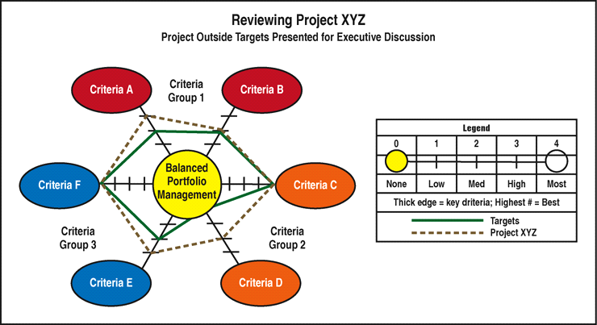
Radar Graphs
Source: The Standard for Portfolio Management, PMI 2nd Edition, page 81, figure 4-18

Slide 57
Monitor Business Strategy Changes
  Identifying early signs of environmental changes and trends
Scanning
  Determining the timing and importance of environmental changes and trends for firms’ strategies and their management
Assessing
Monitoring
  Detecting meaning through ongoing observations of environmental changes and trends
Portfolio Register
Forecasting
  Developing projections of anticipated outcomes based on monitored changes and trends

Slide 58
Portfolio Rebalancing Recommendations
Ensure that the organization continues to invest in only those portfolio components that support strategic goals and objectives
Verify that those investments remain on-track to achieve stated strategic goals and objectives
Recommendations are input to Strategic Change process:
  Realign
  Discontinue

Slide 59
Successful Project Portfolio Management
Successful Project Portfolio Management
How well are we executing?
Can we absorb all the changes?
Are we realizing the promised benefits?
Are we optimizing our capacity?
Are we investing in the right things?

Slide 60
Lessons Learned
Even ‘‘mandatory’’ projects have options
Engaging business leaders in an open, fact-based dialogue is a key outcome of PPM
When seeking to implement resource management for the first time, focus on a staged approach, using quick wins to build momentum and buy-in
Individual project business cases can be compelling, but we need to look at the entire portfolio pipeline to determine the best course of action for the company
Change may impact technology, physical assets, or people; people are the ones who get unsettled by change

Slide 61


